Slide 1

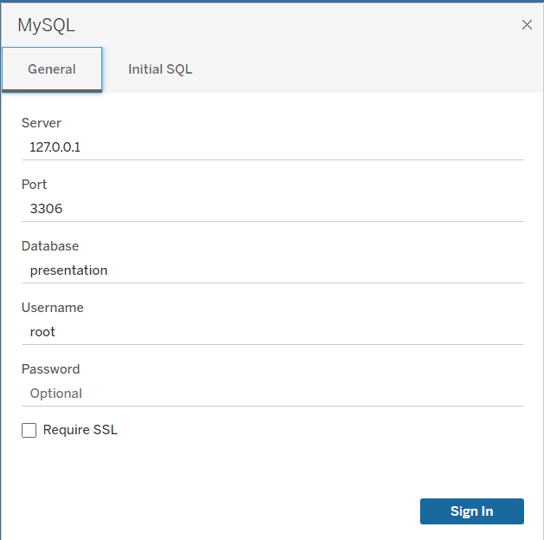

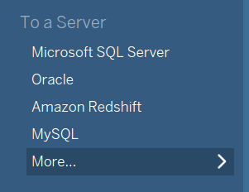
Integrating MySQL with Tableau
3.
1.
Technical
Presentation
2.

Slide 2
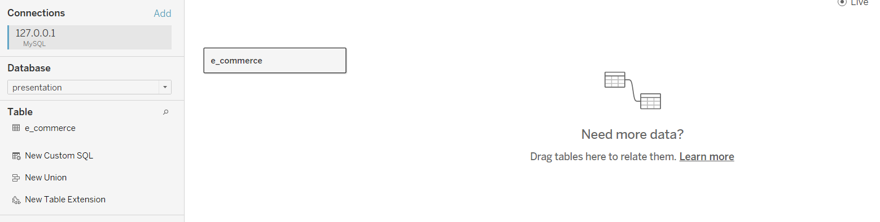
Integrating MySQL with Tableau
3.
1.
Table
Technical
Presentation
2.
Database

Slide 3
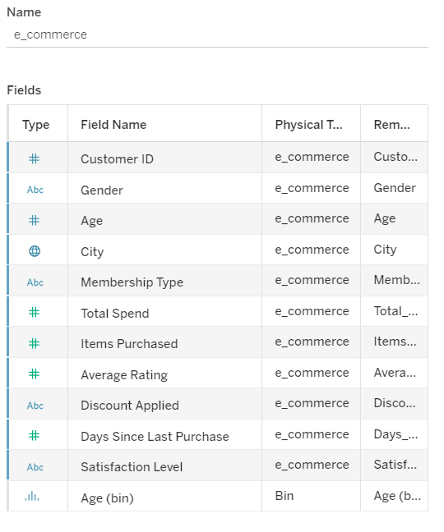

Integrating MySQL with Tableau
7 - Dimensions
Table
4 - Measures
Database

Slide 4
Understanding the Data
7 - Dimensions
Technical
Presentation
4 - Measures

Slide 5
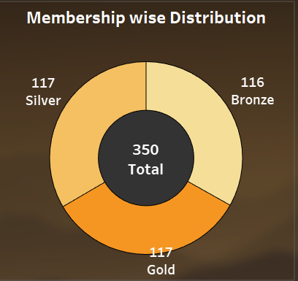



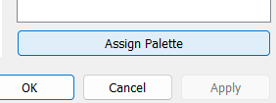
Donut Chart
Create Zero Axis
Sync the Axis
Hide the Zero Line
Assign Color palette
7 - Dimensions
4 - Measures

Slide 6
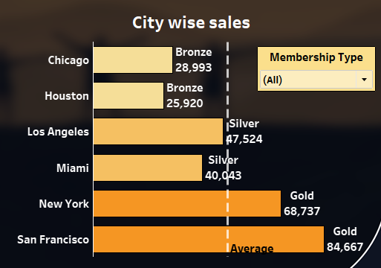

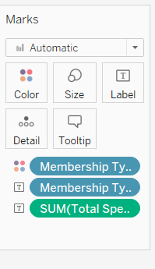
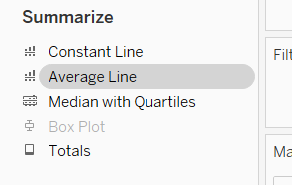
Horizontal Bar Chart
Donut Chart
1.
Create Zero Axis
Sync the Axis
Hide the Zero Line
Assign Color palette
2.
3.

Slide 7
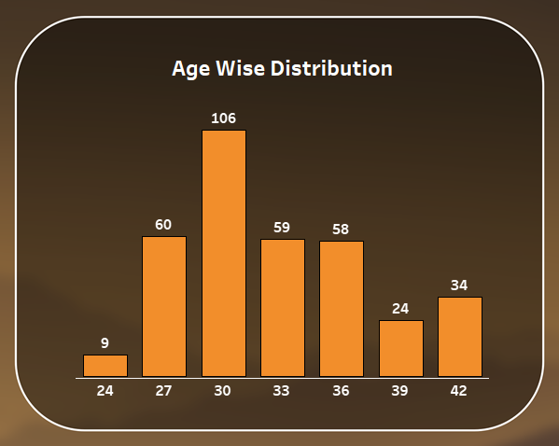
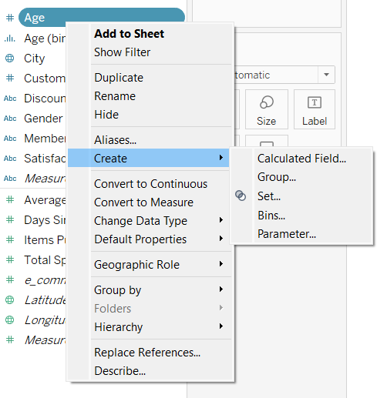
Bar Chart (Bins)
Horizontal Bar Chart
1.
2.
3.

Slide 8
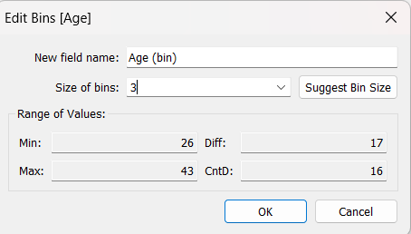

Bar Chart (Bins)
2.
1.
3.

Slide 9
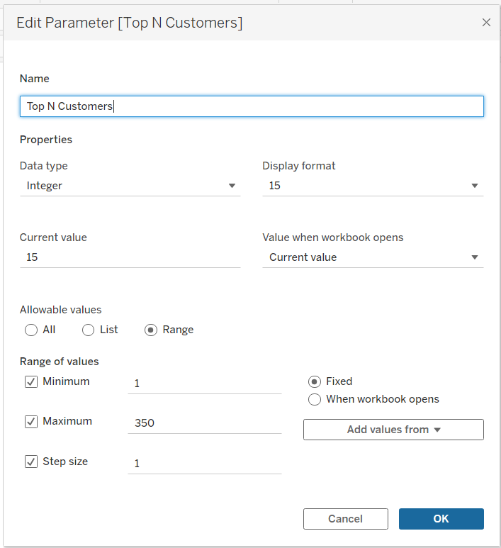
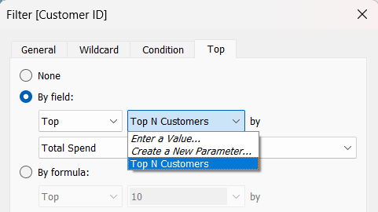
Top Customers (Dynamic Parameter)
Bar Chart (Bins)
2.
1.
2.
1.
3.

Slide 10
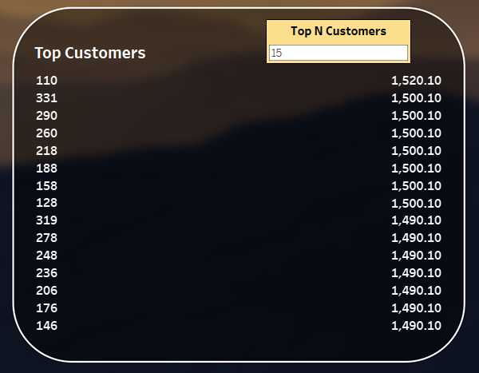
Top Customers (Dynamic Parameter)
1.
Parameter
2.

Slide 11

Top Customers (Dynamic Parameter)
Parameter
Tableau Desktop

Slide 12
Conclusion :
Focus on Bronze Memberships.
sales of Chicago and Houston are not performing well.
Introduce new plans to improve the conversion rate.
1/3 of the Reviews are Unsatisfied.
Thank you
Tableau Desktop

Slide 13
Thank you
Tableau Desktop

